Slide 1
Functions Part 1
- By
Hemlata Kohin

Slide 2
Today’s Objectives
• To learn why you would want to divide your code into smaller, more specific pieces (functions!)
• To be able to define new functions in Python
• To understand the details of function calls and parameter passing in Python
• To use functions to reduce code duplication and increase program modularity

Slide 3
Control Structures (Review)
• A program can proceed:
–In sequence
–Selectively (branching): making decisions
–Repetitively (iteratively): looping
–By calling a function
Focus of todays lecture

Slide 4
Introduction to Functions

Slide 5
Functions We’ve Seen
• We’ve actually seen (and used) two different types of functions already!
• Built-in Python functions
–For example: print(), input(), casting functions such
as int() or float() or str(), etc.
• Our program’s code is contained completely inside the main() function
–A function that we created ourselves

Slide 6
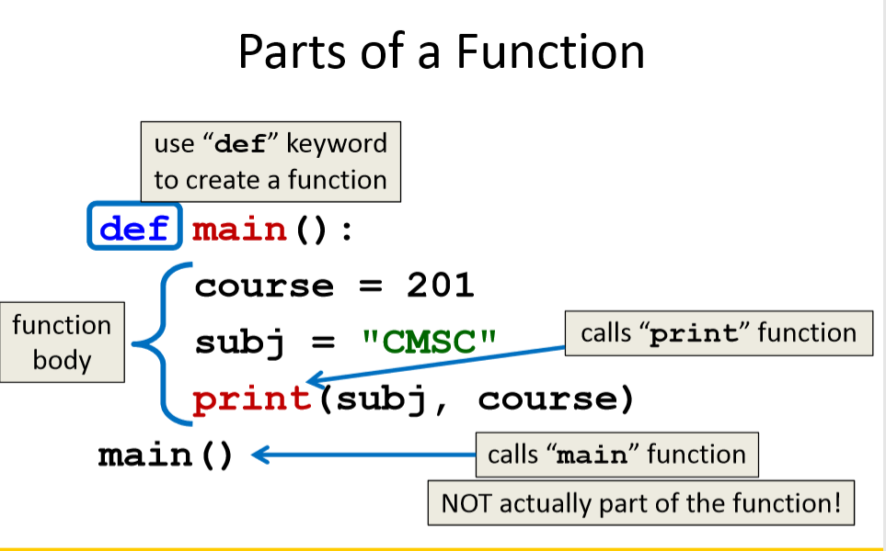

Slide 7
Why Use Functions?
• Functions reduce code duplication and make programs more easy to understand and maintain
• Having identical (or similar) code in more than one place has various downsides:
Have to write the same code twice (or more)
2. Must be maintained in multiple places
3. Hard to understand big blocks of code everywhere

Slide 8
What are Functions?
• A function is like a subprogram
–A small program inside of a program
• The basic idea:
–We write a sequence of statements
–And give that sequence a name
–We can then execute this sequence at any time by
referring to the sequence’s name

Slide 9
When to Use Functions?
• Functions are used when you have a block of code that you want to be able to:
–Write once and be able to use again
• Example: getting valid input from the user
–Call multiple times at different places
• Example: printing out a menu of choices
–Change a little bit when you call it each time
• Example: printing out a greeting to different people

Slide 10
Function Vocabulary
• Function definition:
–The part of the program that creates a function
–For example: def main(): and the lines of code that are indented inside of def main():
• Function call:
–When the function is used in a program
–For example: main() or print("Hello")

Slide 11
Function Example

Slide 12
A simple function example
def hello_function():
print (“Hello World. Its me.”)
Hello_function()
Output: Hello World. Its me.

Slide 13
How Parameters Work

Slide 14
Functions and Parameters
• Each function is its own little subprogram
–Variables used inside of a function are local to that function
–Even if they have the same name as variables that appear outside that function
• The only way for a function to see a variable from another function is for that variable to be passed in as a parameter

Slide 15
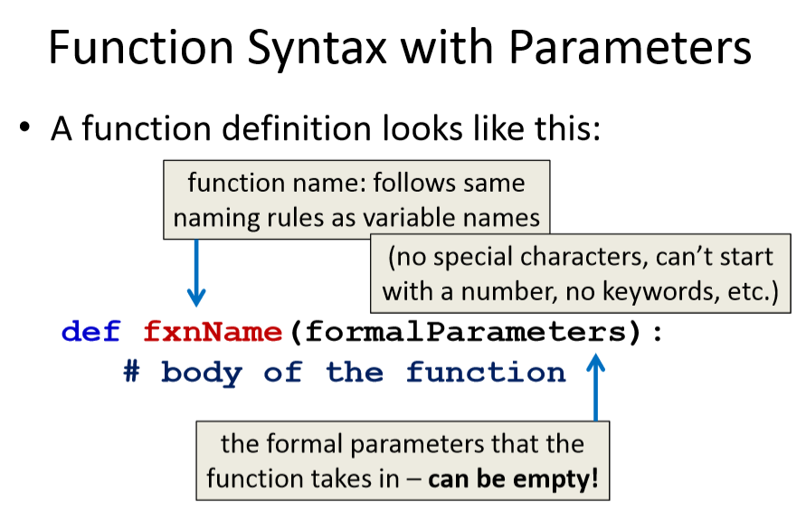

Slide 16
Formal Parameters
• The formal parameters, like all variables used in the function, are only accessible in the body of the function
• Variables with identical names elsewhere in the program are distinct from those inside the function body
–We call this the “scope” of a variable

Slide 17
Calling Functions with Parameters

Slide 18
Calling with Parameters
• In order to call a function that has parameters, use its name, and inside the parentheses place the argument(s) you want to pass
myFunction("my string", numVar)
• These variables are the arguments(the values) that are passed to the function

Slide 19
Initializing Formal Parameters
• The formal parameter is assigned the value of the argument
When we call sing("Maya"), it as if the following statement was executed in sing() person = "Maya“
def sing(person):
print("Happy birthday, dear", person, "...")

Slide 20
Multiple Parameters
• One thing we haven’t discussed is functions with multiple parameters
• When a function has more than one parameter, the formal parameters and the arguments are matched up based on position
–First argument becomes the first formal parameter, etc

Slide 21
Multiple Parameters in sing()
• Let’s add a second parameter to sing() that will take in the person’s age as well
• And print out their age in the song
def sing(person, age):
print("Happy birthday, dear", person, "...")
print("You're", age, "years old now...")

Slide 22
Multiple Parameters in sing()
• What will happen if we use the following call to the sing() function in main()?
def main():
sing("Maya", 7)
main()
It will print out:
Happy birthday, dear Maya
You’re 7 years old now...

Slide 23
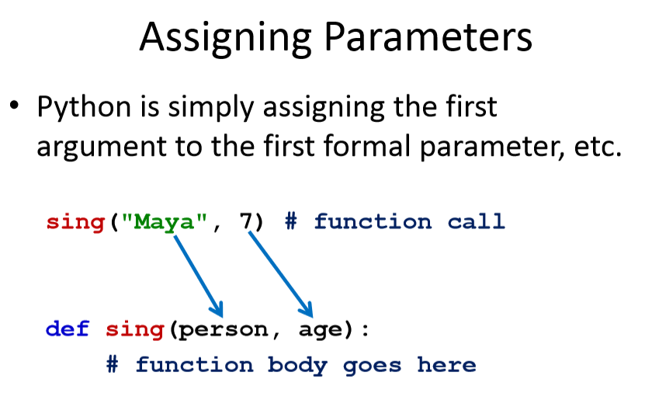

Slide 24
Parameters Out-of-Order
• What will happen if we use the following call to the sing()function in main()?
def main():
sing(7, "Maya")
main()
• It will print out:
Happy birthday, dear 7
You’re Maya years old now...

Slide 25
Parameters Out-of-Order
• Python isn’t smart enough to figure out what you meant for your code to do
–It only understands the exact code
• That’s why it matches up arguments and formal parameters based only on their order

Slide 26
Any Questions?

